Slide 1
Project Title: DevSecOps Pipeline Implementation for a COTS Product
01 : SANDBOX Pipelines
02 : QA Pipelines
03 : STAGING Pipelines
04 : PRODUCTION Pipelines

Slide 2
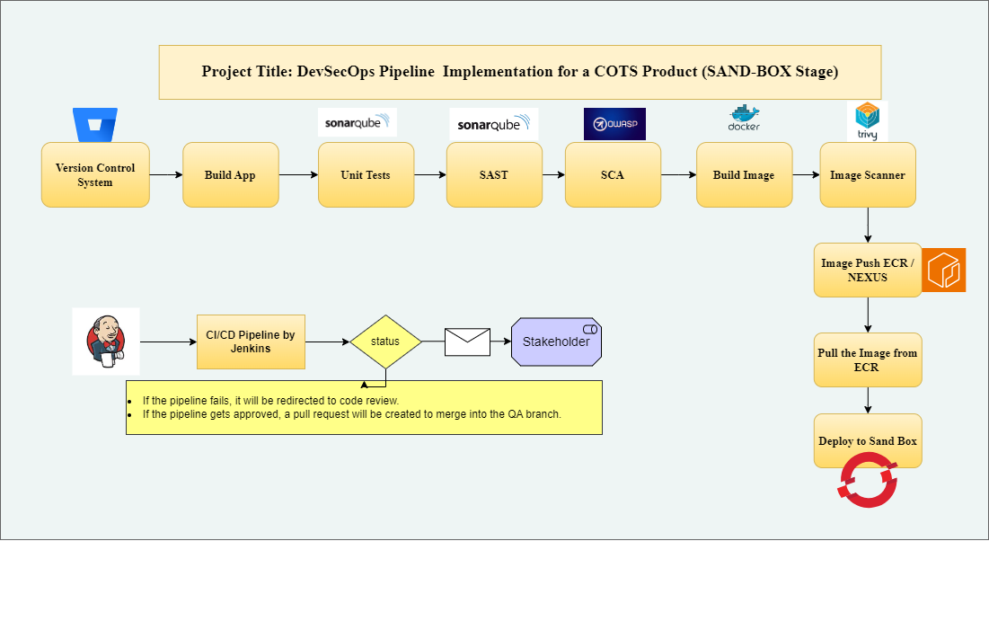

Slide 3
This CI/CD pipeline is to ensure that code quality and security checks are performed automatically during the build process. This integration allows for early detection of issues, reducing the cost and effort required to fix them.
Process of Testing:
Code Scanning:
- The SCA tool scans the codebase and analyzes it against a set of predefined rules or patterns.
Report Generation:
- Generates reports highlighting the identified issues, categorized by severity and type.
3. Remediation:
- Developers review the report, prioritize the issues based on severity, and fix the identified problems.4.Re-4. 4. Scanning:
After remediation, the code is re-scanned to ensure that the issues have been resolved and no new issues have been introduced.
SCA - Software Composition Testing Analysis
SAST - Static Analysis of Security Code Testing
Note:
Typically, DAST is done after QA since it is emulating attacks on a running application; but we can make the decision to “Shift DAST left” (moving DAST earlier in the process of development) we will be able to detect vulnerabilities sooner, which saves time and money.

Slide 4
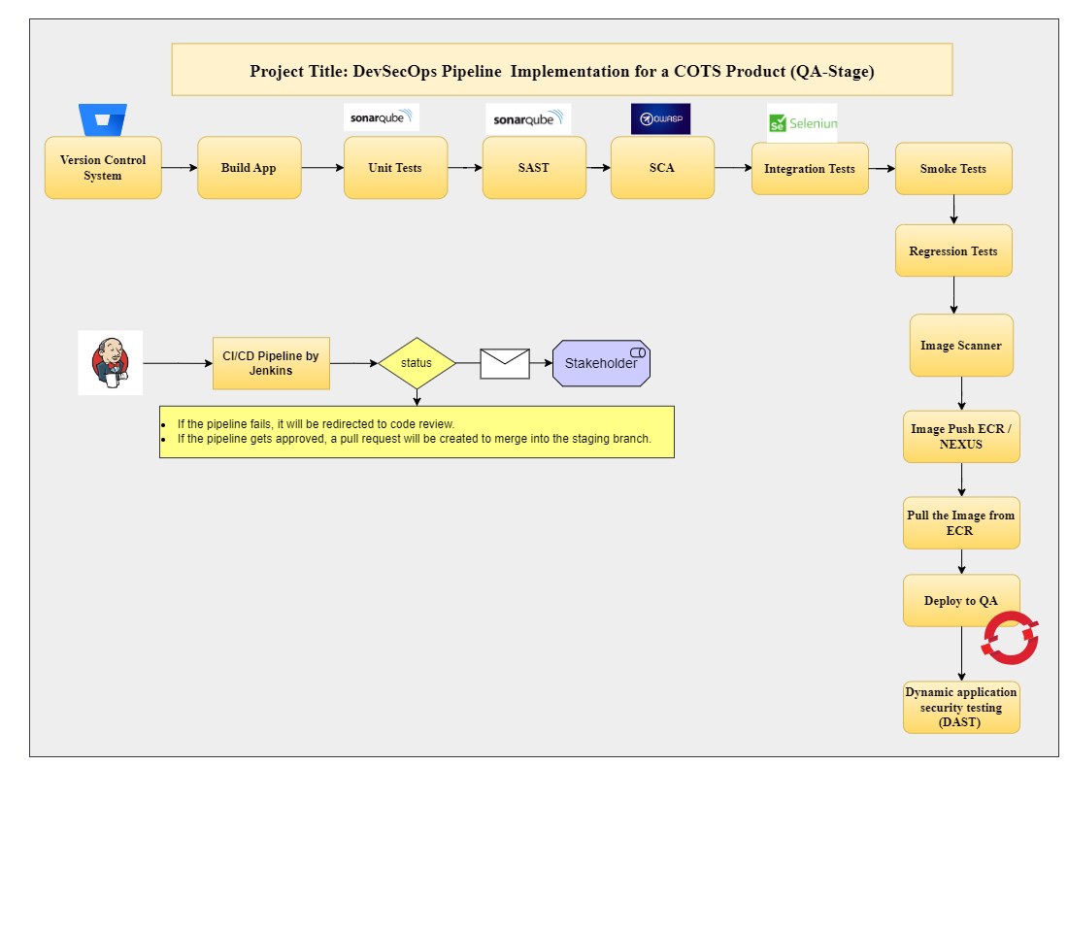

Slide 5
In this QA section, we incorporate several testing methodologies into the Jenkins pipeline to ensure a robust security posture for the application:
Smoke Tests :
Purpose: Quickly verify if the application is stable enough for further testing.
Implementation: Create lightweight test scripts to perform basic checks of critical functionalities after deployment. Run these tests early in the pipeline to catch obvious issues before proceeding with more extensive testing.
Automated Unit and Integration Testing :
Purpose: Validate individual components and their interactions to ensure they function correctly.
Unit Tests: Implement automated tests for each component of the application to verify that each unit of code performs as expected.
Integration Tests: Verify that different components of the application work together as intended. Run these tests after the unit tests to ensure interactions between components are functioning correctly.
Basic Regression Testing :
Purpose: Ensure that new changes do not introduce regressions or break existing functionalities.
Implementation: Develop and execute a suite of tests that cover key functionalities and previously fixed issues. This helps verify that recent changes have not adversely affected existing features.
Basic Security Scans/Testing :
Purpose: Identify vulnerabilities and security issues in the application before deployment.
Implementation: Incorporate basic security assessments such as static code analysis or simple vulnerability scans to catch common security issues early in the pipeline.
Dynamic Application Security Testing (DAST) :
Purpose: Assess the application’s security by simulating attacks against a running instance.
Implementation: Use a DAST tool like OWASP ZAP to scan the deployed application in the staging environment. This helps identify vulnerabilities in real-time interactions and assess how the application handles potential security threats.

Slide 6
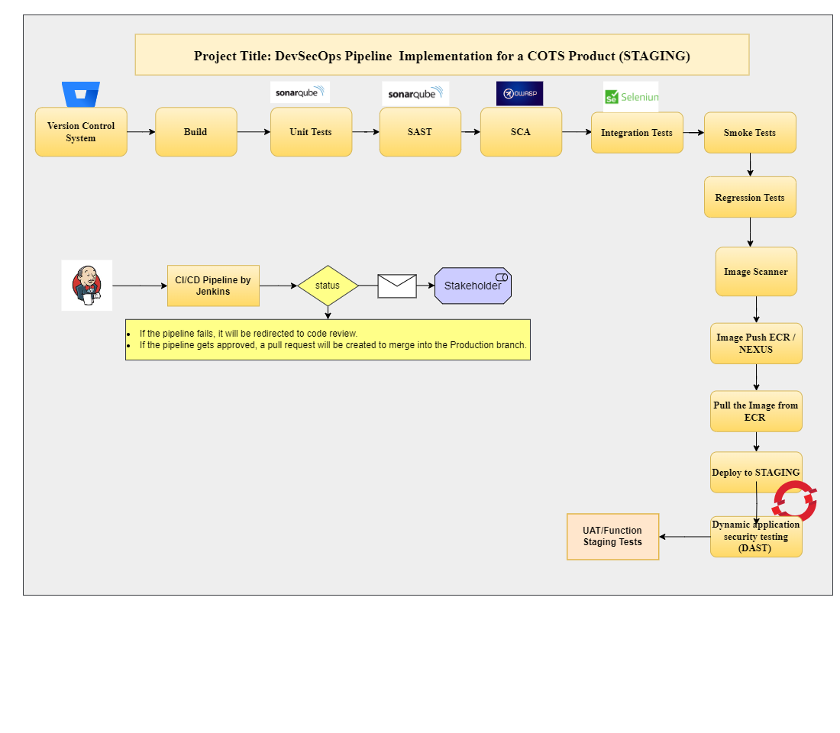

Slide 7
Staging tests are a suite of tests run in the staging environment to validate that the application works as expected before it is deployed to production. These tests typically include a mix of functional, performance, and regression tests to ensure that the new version of the application behaves correctly and meets the required quality standards. Here are some common types of tests that might be included in staging tests:
Functional Tests: These tests verify that the application's features work as intended. They often include user interface tests, API tests, and end-to-end tests.
Regression Tests: These tests ensure that new changes have not introduced any regressions (i.e., bugs that break previously working functionality). They typically run the entire suite of automated tests that have been accumulated over time.
Performance Tests: These tests assess the application's performance under various conditions. They might include load tests, stress tests, and scalability tests to ensure the application can handle the expected load.
Integration Tests: These tests verify that different modules or services within the application interact correctly. They ensure that the integration points between various components work as expected.
User Acceptance Tests (UAT): These tests are often performed by end-users or stakeholders to validate that the application meets their requirements and works as expected in real-world scenarios.
Security Tests: These tests check for vulnerabilities and ensure that the application is secure. They might include penetration testing, vulnerability scanning, and other security assessments.

Slide 8


Slide 9
For Production the recommended Strategy: Blue-Green Deployment :
Overview:
Blue-Green Deployment helps release new versions of applications smoothly and with minimal downtime.
Blue Environment: The current version of your application that's live and handling all user traffic.
Green Environment: The new version of our application, where we will test and prepare the update.
Process:
3. Deploy to Green: Install the new version in the Green environment.
4. Test Green: Make sure everything works well in the Green environment.
5. Switch Traffic: Move user traffic from Blue to Green. This can be done all at once or gradually.
6. Monitor: Keep an eye on the Green environment to ensure it’s running smoothly.
7. Rollback (if needed): If issues arise, switch back to the Blue environment quickly.
8. Complete Switch: Once Green is confirmed to be stable, decommission Blue or use it for future updates.
Benefits:
No Downtime: Users experience no interruptions.
Easy Rollbacks: Quickly revert to the old version if something goes wrong.

